Slide 1
Collective Intelligence Presentation
Hagigat Ahmadova
ezzq1i@inf.elte.hu

Slide 2
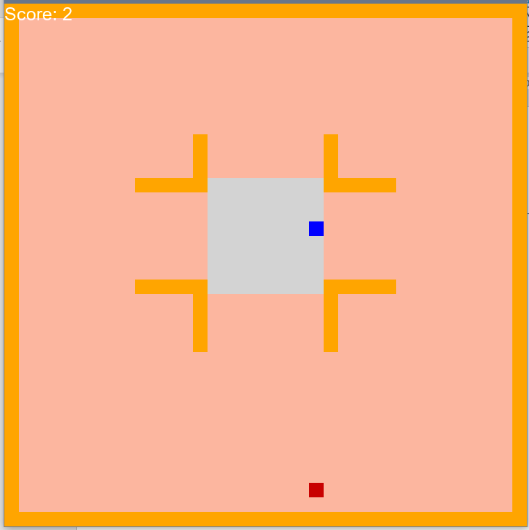
Task
Create a Multi Agent Reinforcement Learning environment
Goal
Agents have to find shortest way to box.
Collect the box and bring it back to delivery zone
Image(s)

Slide 3
Environment
2D Environment ​
Environment has multiply obstacles
​There are 64 empty slot in delivery area
1 pickable object (block)
Image(s)

Slide 4
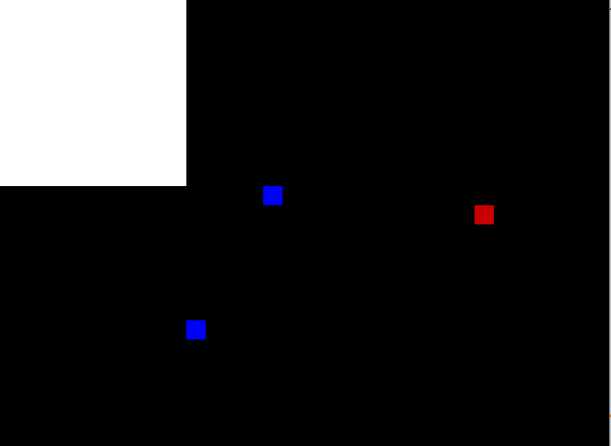

Slide 5
Observation spaces
Nearby environment
Agents check for collusion from 4 directions
Agents check whether they are reducing distance towards the target on each move and receive reward or negative
Action spaces
Straight -> [1,0,0]
Right turn -> [0,1,0]
Left turn -> [0,0,1]

Slide 6
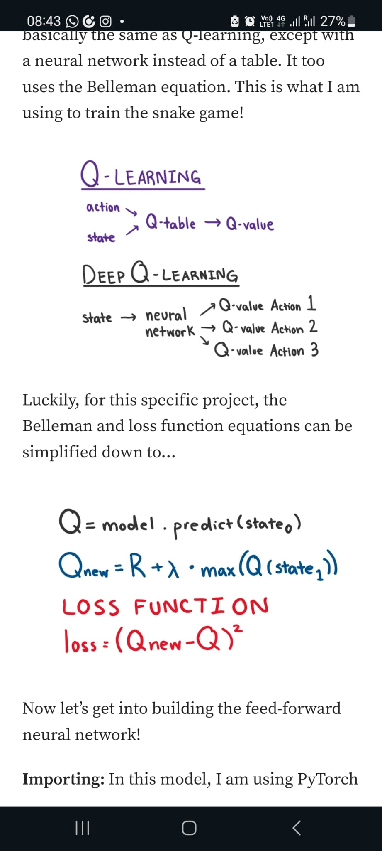
Model & Rewards
Q-Learning
Positive
Distance reduction +1
Box pickup +10
Box delivery +10
Negative
Distance increase -1
Collusion -10

Slide 7
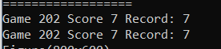
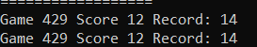
Evaluation metrics
Number of Games
Record
Score

Slide 8
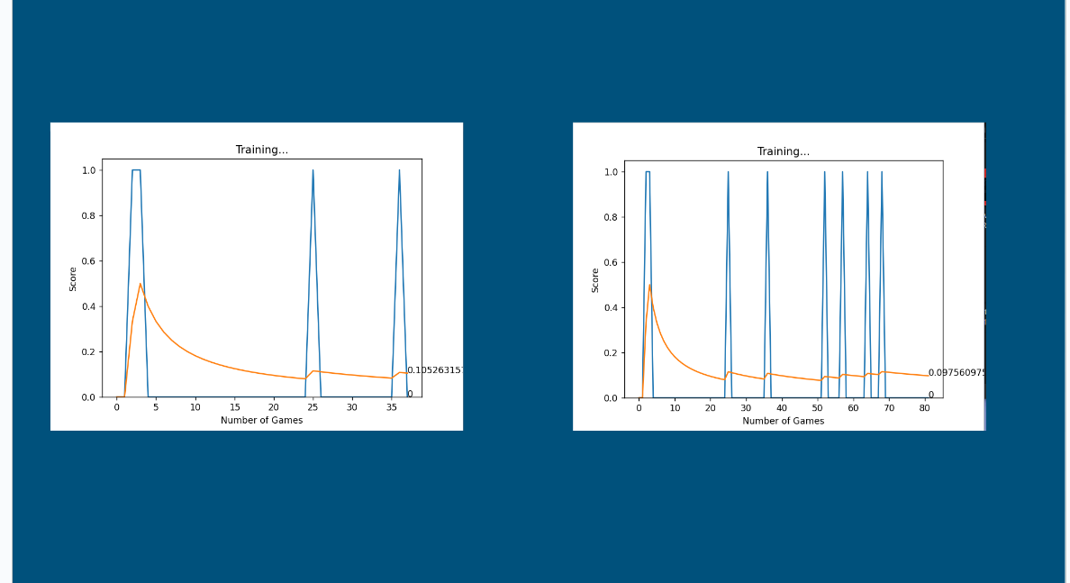
Results Test/Comparison 1 Example
Test/comparison description

Slide 9
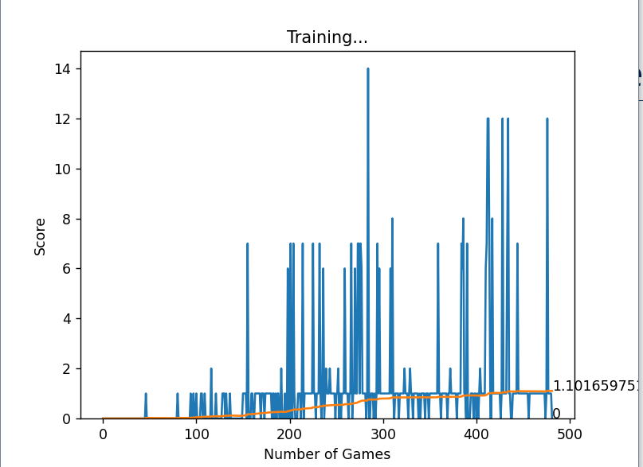
Results Test/Comparison 2 Example

Slide 10
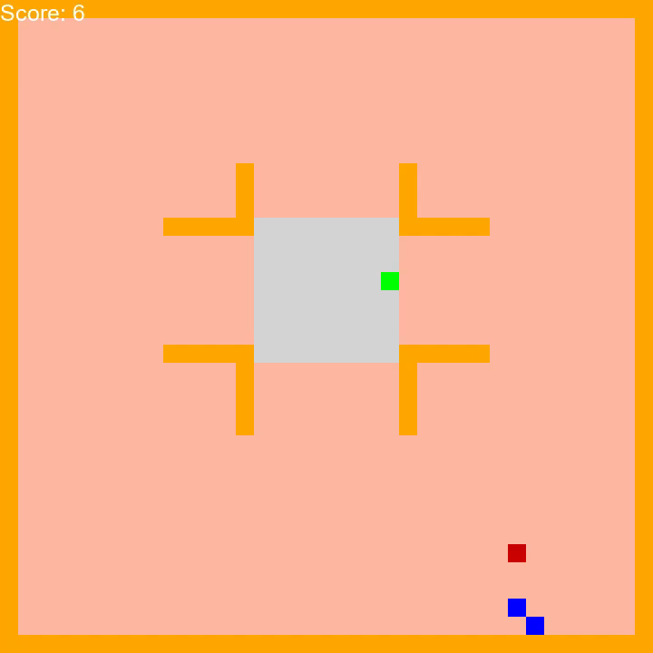

Slide 11
Conclusion and Further Work Example
Conclusion
In conclusion the agents learn on a paralel level
There are 2 separate agents learning
Further Work
A more productive learning model can be implemented
Multi box format can be reimplemented to work properly

Slide 12
Thank You for Your attention!
Hagigat Ahmadova
ezzq1i@inf.elte.hu
Questions?

